Slide 1

THE NUTRITIONAL SLUG
THE GOLD TEAM
PROJECT OWNER: JOHN LARA
DEVELOPERS: SANYAM SACHEVA
VIDISHA NEVATIA
ROBERTO OREGON
DYLAN SALAK
DATE: JULY 22 2020

Slide 2
APP PURPOSE
HOW YOU SHOULD EAT?
WHAT YOU CAN EAT!
FULFILL YOUR CRAVINGS WITH THE HEALTHIEST OPTION.

Slide 3
GOALS SET
Search for a food product using API
Progress of macros intake/ day
Food Log of each Day

Slide 4
GOALS ACHIEVED
Search for food product Using Web scraping
Add custom Food entry
Daily Progress Of Macros
Food Log
Monthly Progress

Slide 5
ACCOMPLISHMENTS
Was able to achieve more than we planned for
Learned to work while abiding scrum practices
Work in a group with given time frames
Super proud of our project

Slide 6
CHALLENGES
Working with different time zones
01
Learning and Using Swift
02
Working with Git commits
03
Working with Scrum Practices
04

Slide 7
SCREENSHOTS

Slide 8
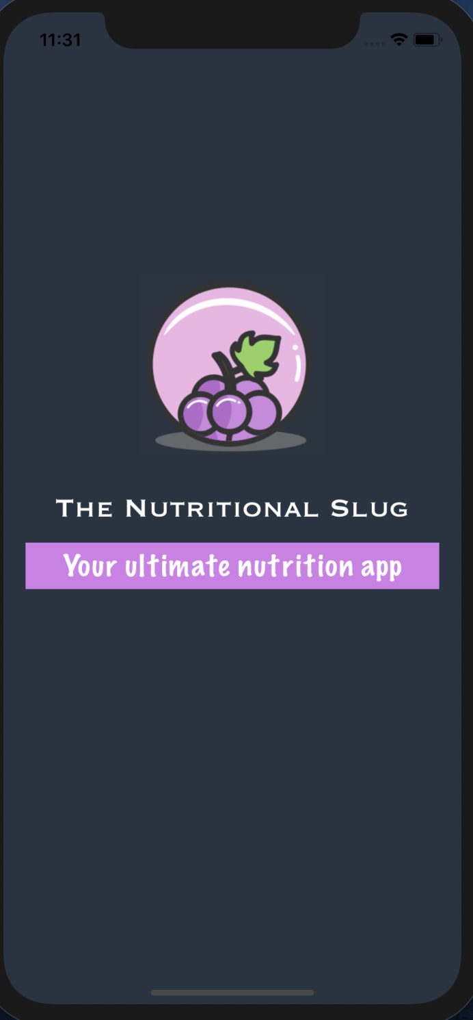

LAUNCH SCREEN

Slide 9
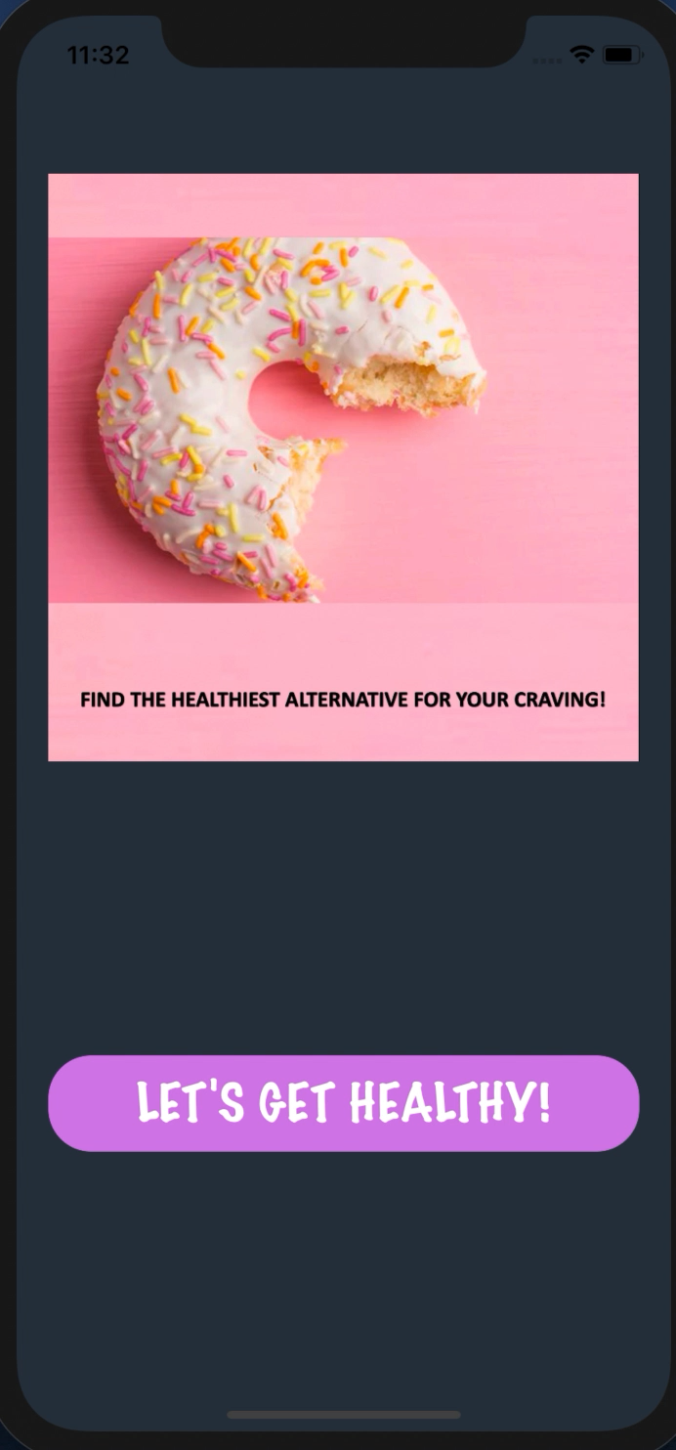
SLIDESHOW TO SUMMARIZE APP

Slide 10
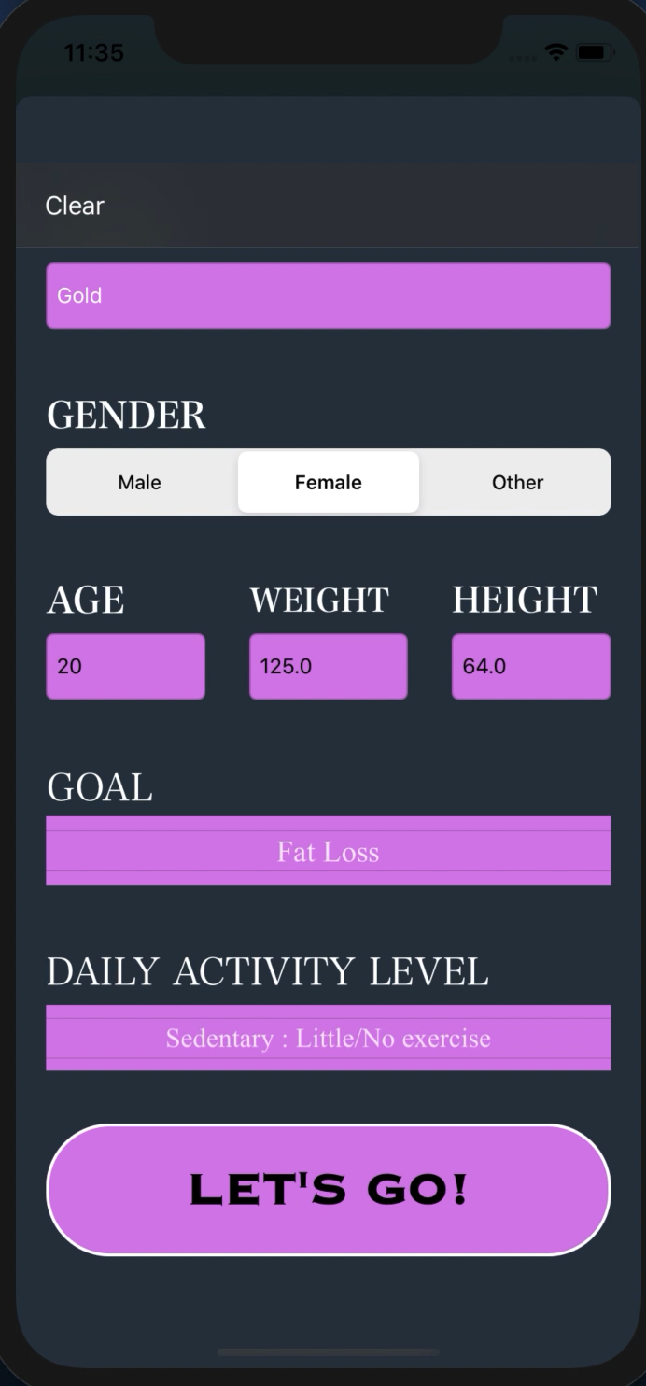
SETTINGS PAGE

Slide 11
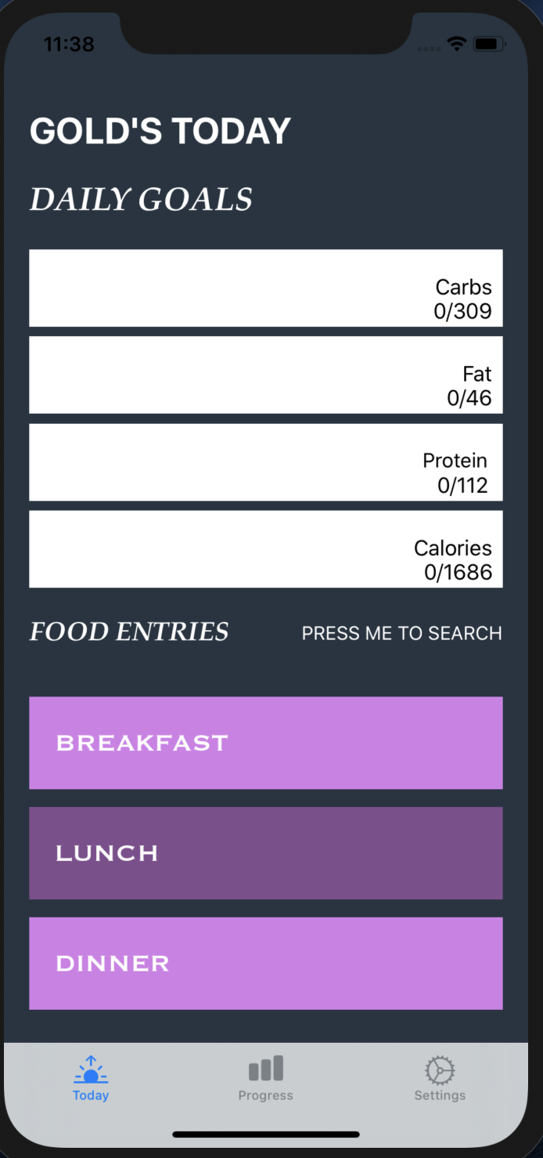
TODAY TAB

Slide 12
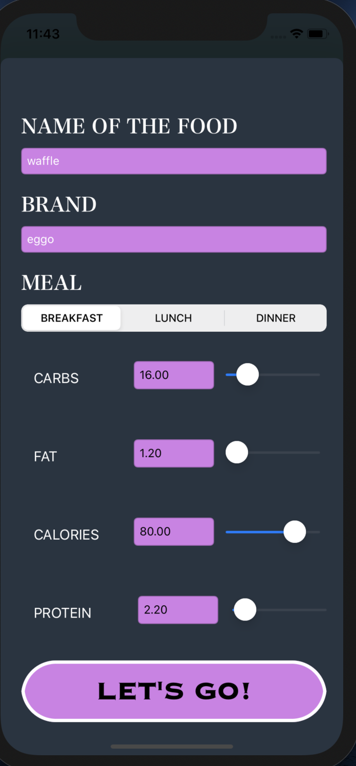
Custom Food
Addition

Slide 13
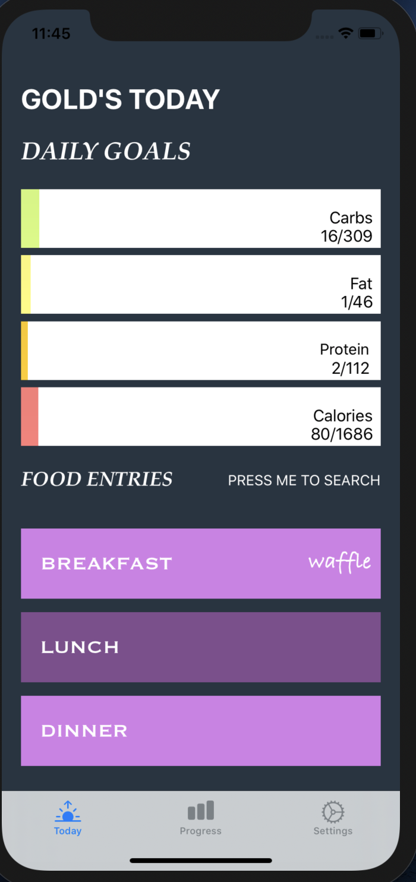
TODAY TAB WITH UPDATED PROGRESS & FOOD

Slide 14
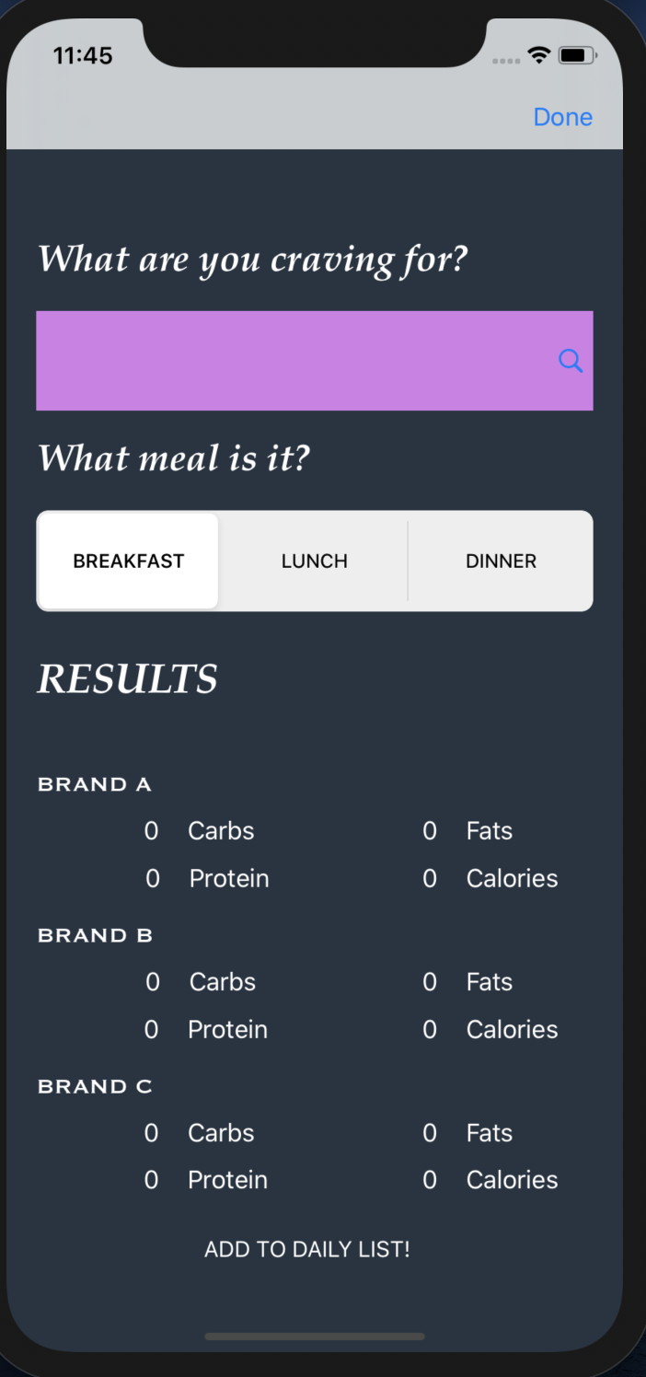
SEARCH PAGE 1

Slide 15
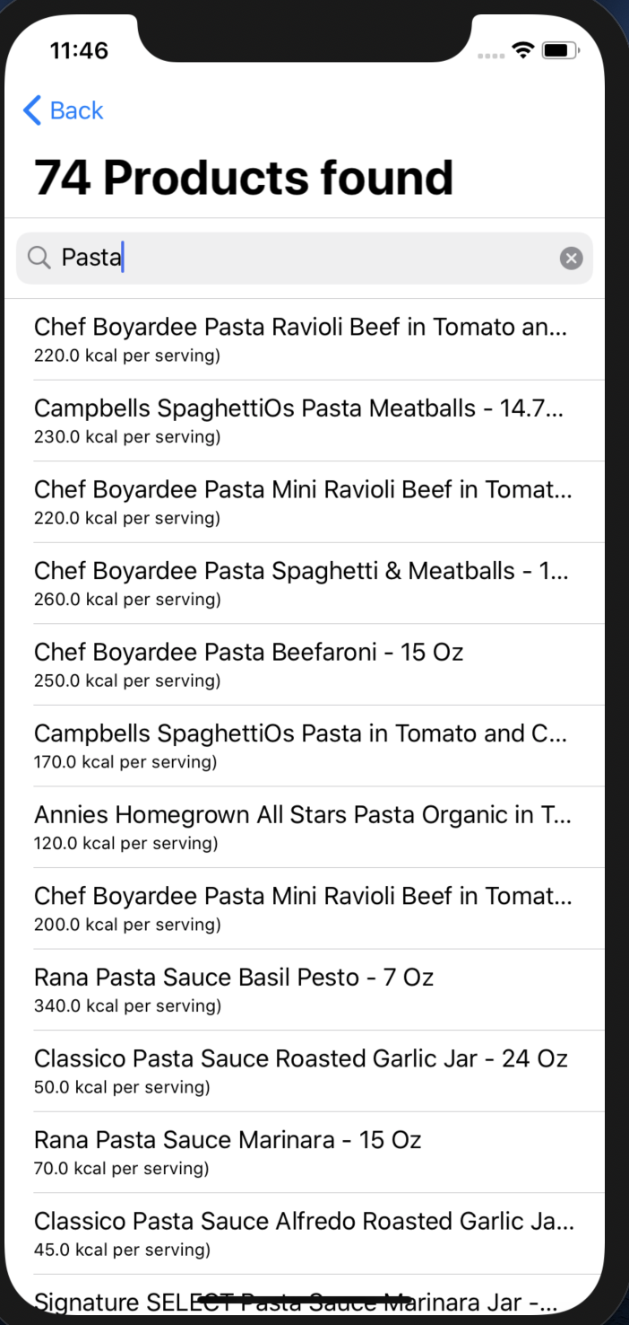
SEARCH FOR FOOD ITEM

Slide 16
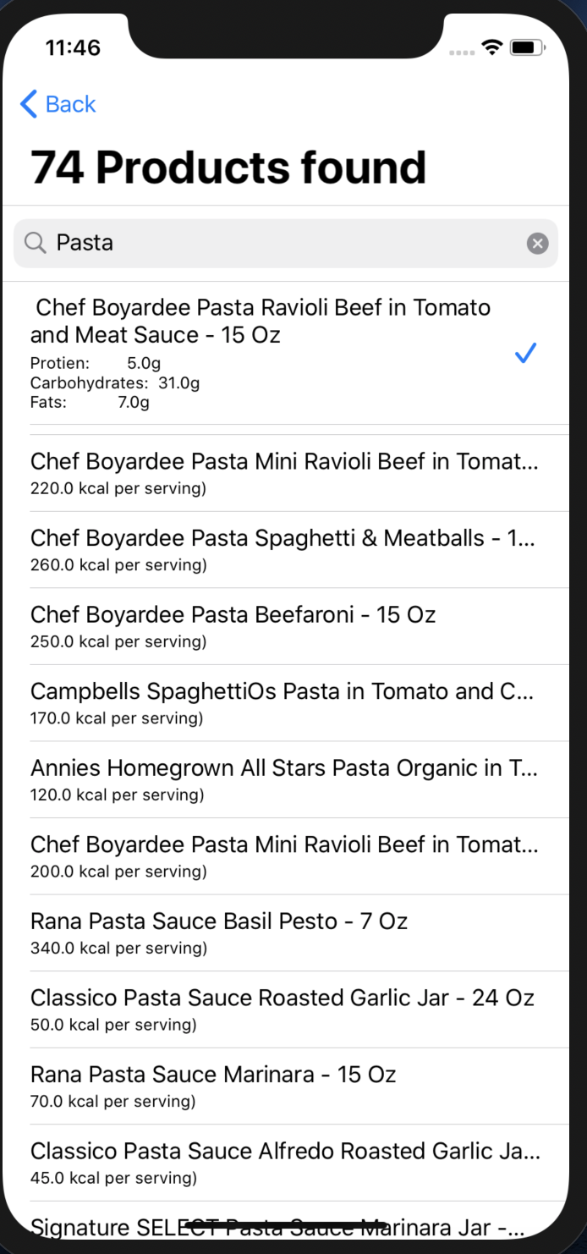
SELECT ONE ITEM

Slide 17
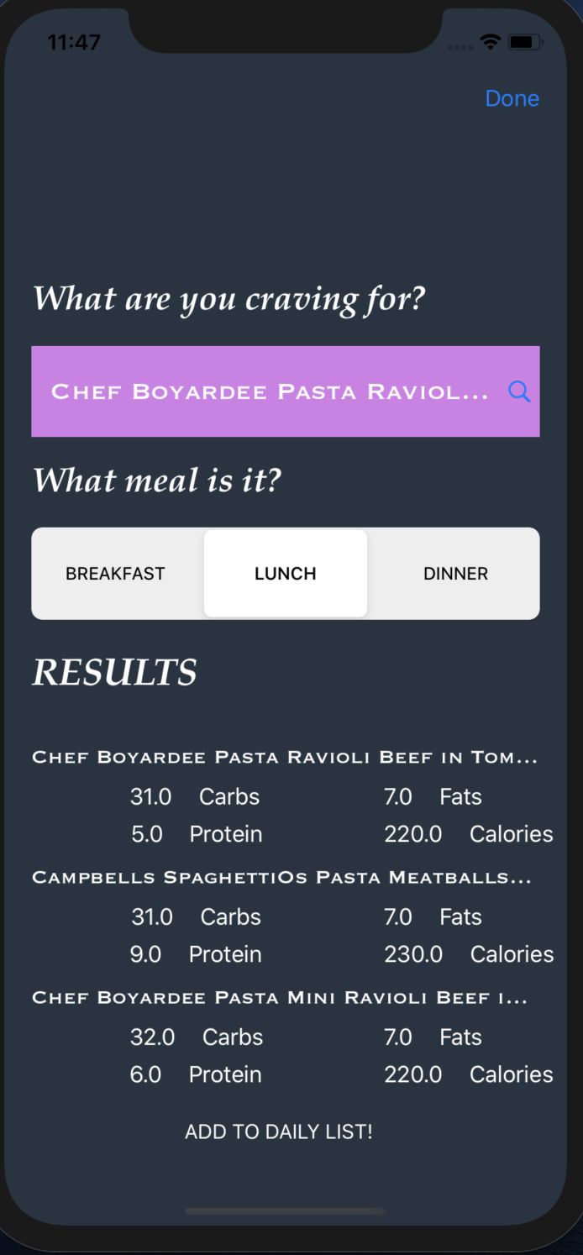
SEARCH RESULTS REFLECT ON THIS PAGE

Slide 18
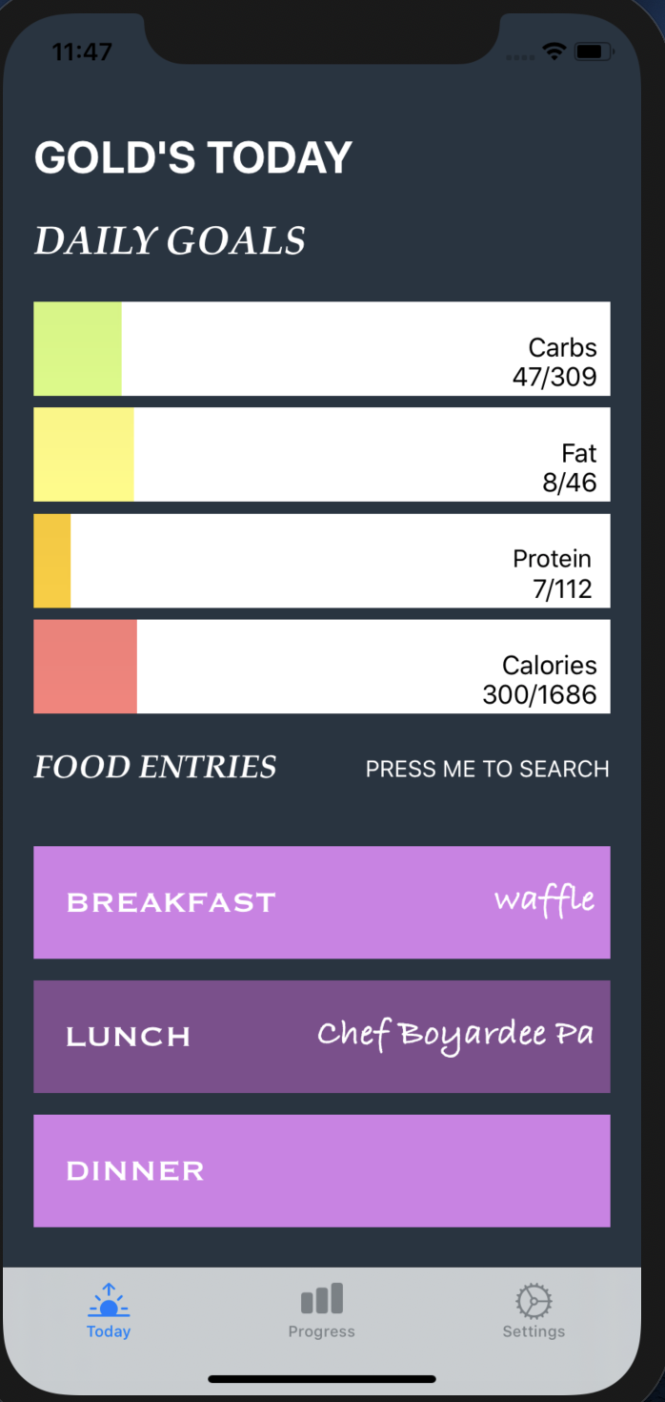
TODAY TAB WITH UPDATED PROGRESS & FOOD

Slide 19
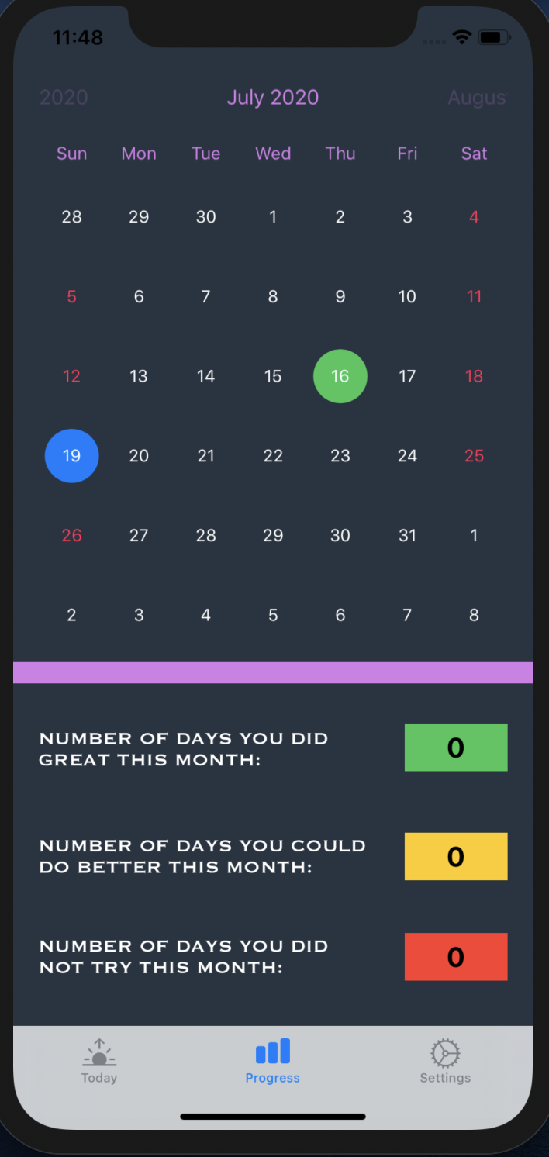
PROGRESS PAGE

Slide 20
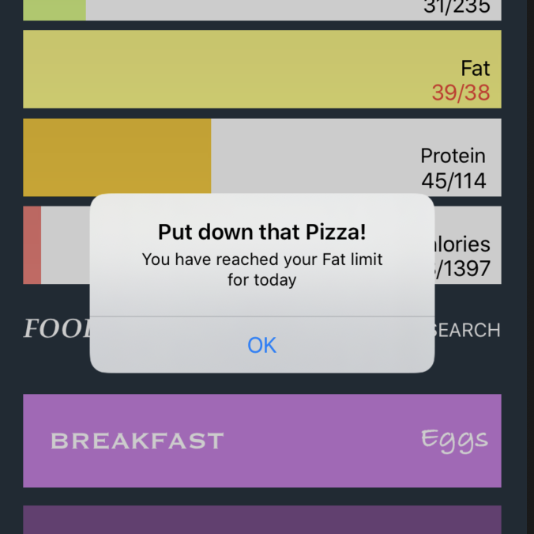
IN CASE YOU EXCEED YOUR MACROS DAILY LIMIT

Slide 21
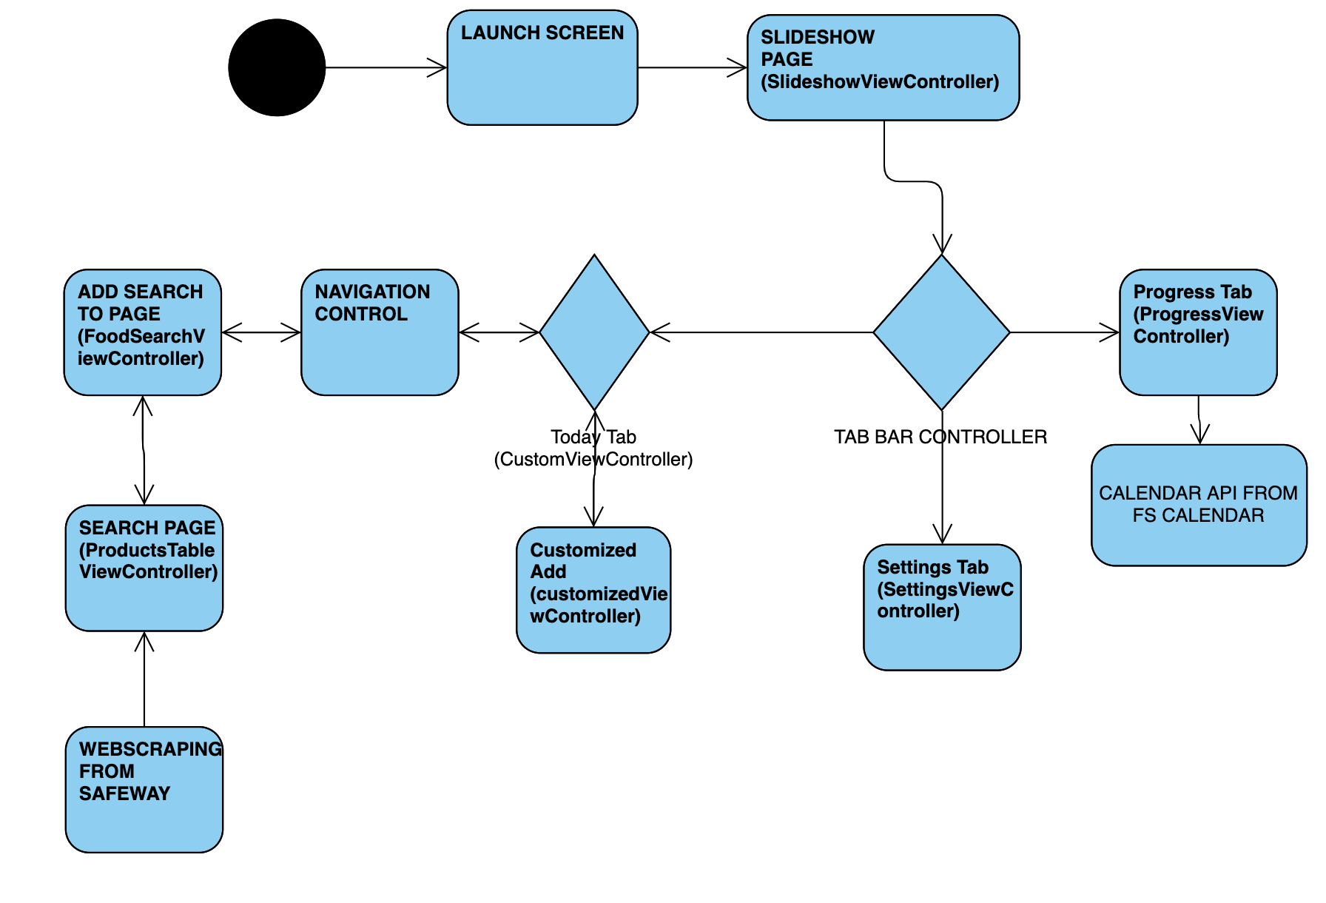
STRUCTURE

Slide 22
TECHNOLOGIES USED
XCODE
SWIFT
SQL
PYTHON
HTML
PHP

Slide 23
PROJECT MANAGEMENT TECHNIQUES USED
Scrum Practices
Pair Programming
Continuous Integration

Slide 24
PROJECT MANAGEMENT TECHNIQUES USED
GitHub: To work collaboratively
Discord: Main general Channel And Resources Channel
Trello: To manage scrum board
Zoom: To communicate

Slide 25
THINGS ENJOYED
Being able to solve the challenges
LEARNING TO WORK with Swift and Xcode
WORKING IN A GROUP

Slide 26
THINGS NOT ENJOYED
GIT MERGE ISSUES!!!

Slide 27
What we will keep doing
Keep using Trello helps organization.
Meetings and discussions are well organized.
Keep announcing on discord when you start something.

Slide 28
What we STOP doing
DELETING COMMITS WITHOUT INFORMING THE PERSON WHO PUSHED

Slide 29
What we WISHED WE HAD DONE
Do an add to cart feature to connect to Safeway online
LIST OF FOOD PER MEAL
Implement a weight tracker

Slide 30
HOW COVID IMPACTED THE PROJECT
In person meetings definitely have an edge over online ones.

Slide 31
THANKYOU!

